Slide 1
Introduction to Text Classification

Slide 2

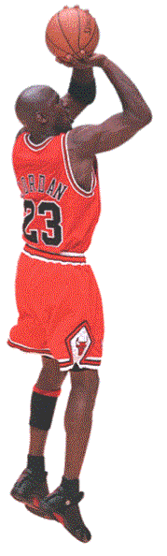
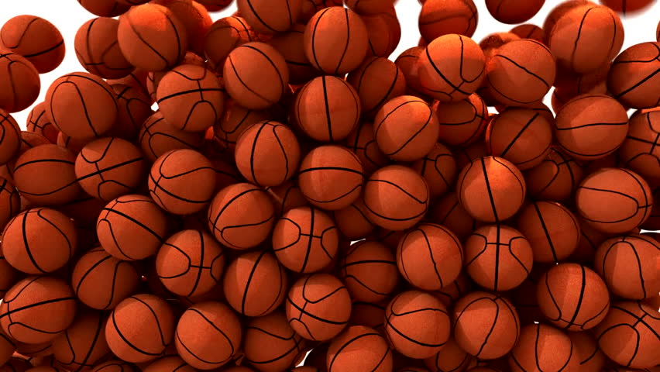
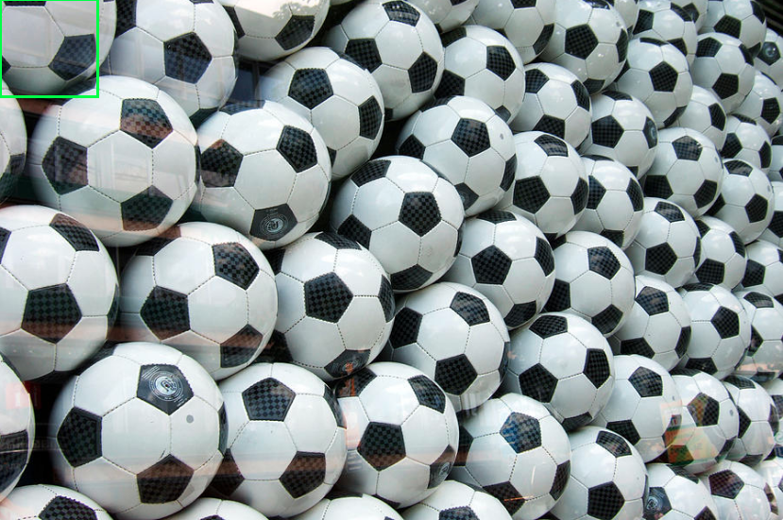
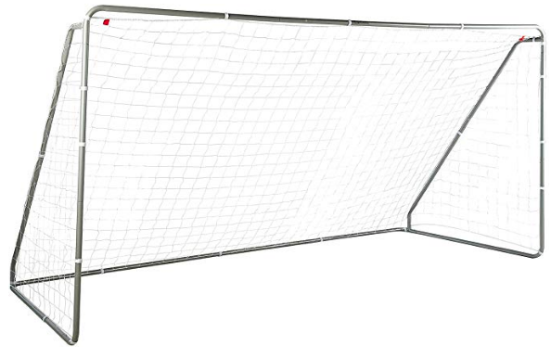
분류 (Classification)
= Categorization
Classes
Classifier
Input Data
Basket Ball
Soccer Ball
https://www.shutterstock.com/video/clip-10275593-basketballs-fill-screen-transition-composite-overlay
https://fineartamerica.com/featured/many-soccer-balls-matthias-hauser.html

Slide 3

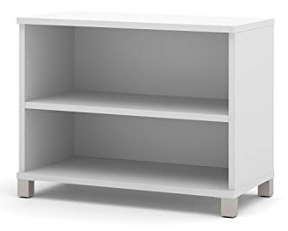

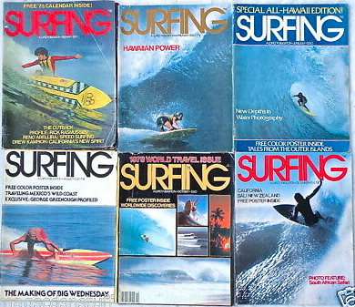
텍스트 분류 (Text Classification)
Text = (모든 형태의) 글
Classes
Classifier
Input Data
Cooking
Surfing
https://www.shutterstock.com/video/clip-10275593-basketballs-fill-screen-transition-composite-overlay
https://fineartamerica.com/featured/many-soccer-balls-matthias-hauser.html

Slide 4
문서 분류 (Document Classification)
Output
Classifier
Input
Document 1
Document 2
Cooking
Document 3
Class 1
Document 4
Document 5
Surfing
Class 0
Document 6
Document 7
Document 8
Document 9
Document 10
Document 11
https://www.shutterstock.com/video/clip-10275593-basketballs-fill-screen-transition-composite-overlay
https://fineartamerica.com/featured/many-soccer-balls-matthias-hauser.html

Slide 5
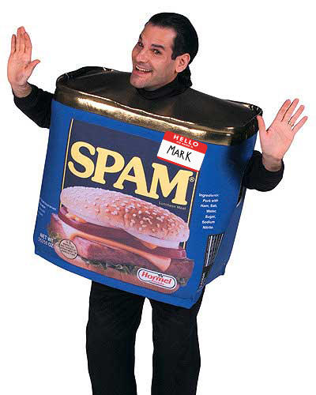
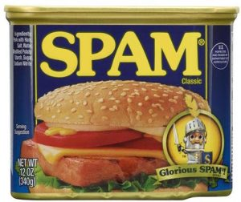
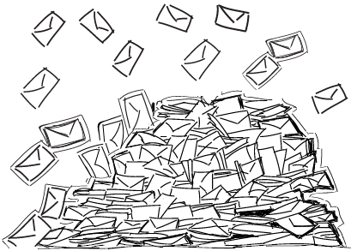

스팸 필터링 (Spam Filtering)
Output
Classifier
Input
Email 1
Class 1
Email 2
Email 3
Email 4
Email 5
Email 6
Class 0
Email 7
Email 8
Email 9
Email 10
...
https://www.shutterstock.com/video/clip-10275593-basketballs-fill-screen-transition-composite-overlay
https://fineartamerica.com/featured/many-soccer-balls-matthias-hauser.html

Slide 6

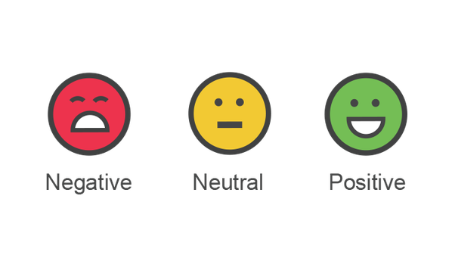

감성 분석 (Sentiment Analysis)
https://www.shutterstock.com/video/clip-10275593-basketballs-fill-screen-transition-composite-overlay
https://fineartamerica.com/featured/many-soccer-balls-matthias-hauser.html

Slide 7
Text Classification
output
input
^
(estimated)
class
c ← γ(d)
document
classification function

